Slide 1
Smart Water Level Monitoring and Control System Using ESP8266 and Blynk
SUDHARSAN S - 210701266
SWETHA ADLURU - 210701276

Slide 2

PROBLEM STATEMENT
To develop an efficient solution for water management, this project aims to create a smart water level monitoring and control system using ESP8266 and Blynk. The system will provide accurate, real-time water level measurements, enable remote access, and improve water usage efficiency to prevent wastage and shortages.

Slide 3

ABSTRACT
Water management is a crucial aspect of both residential and industrial settings, often challenged by the limitations of traditional monitoring methods that are manual, time-consuming, and prone to errors. To address these issues, this project proposes the development of a smart water level monitoring and control system utilizing the ESP8266 microcontroller and the Blynk platform. The system employs ultrasonic sensors to accurately measure the water levels in storage tanks and calculates the percentage of tank fullness. This data is transmitted in real-time to a mobile application, allowing users to monitor water levels remotely. Additionally, the system includes a control feature enabling users to activate or deactivate the water level sensing via the Blynk app. By providing precise measurements and remote control capabilities, the proposed system aims to enhance water management practices, prevent wastage, and ensure optimal water usage, ultimately contributing to sustainable water management solutions.

Slide 4
EXISTING SYSTEM
In many residential and industrial settings, traditional water level monitoring methods rely heavily on manual inspections and mechanical float-based systems. These methods are time-consuming, often inaccurate, and prone to human error. Mechanical floats can get stuck or malfunction, leading to incorrect water level readings and potential overflow or shortage situations. Additionally, manual inspections are labor-intensive and do not provide real-time data, making it difficult to manage water usage efficiently and respond promptly to critical water levels. The lack of remote monitoring and control further exacerbates these issues, as users cannot easily access water level information or adjust settings without being physically present at the tank.

Slide 5
PROPOSED SYSTEM
The proposed system aims to overcome the limitations of traditional methods by developing a smart water level monitoring and control system using the ESP8266 microcontroller and the Blynk platform. The system features ultrasonic sensors to accurately measure water levels in storage tanks and calculate the percentage of tank fullness. This data is then transmitted in real-time to a mobile application, allowing users to monitor water levels remotely. The system also includes a control feature enabling users to activate or deactivate water level sensing through the Blynk app. This smart system provides precise, real-time measurements, enhances convenience with remote monitoring, and improves water management by preventing wastage and ensuring optimal water usage. Additionally, it reduces the need for manual inspections, thereby saving time and labor, and allows for immediate response to critical water levels.

Slide 6
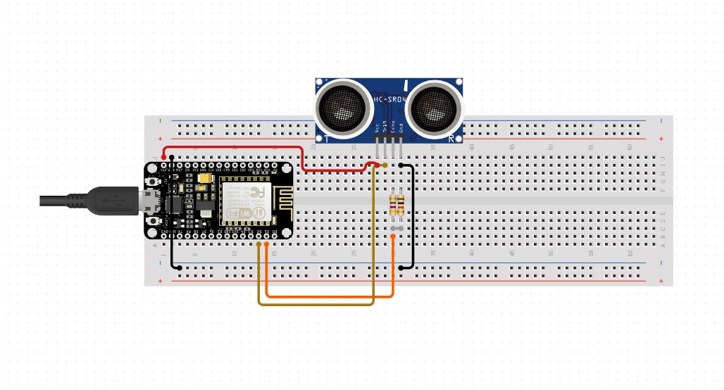
ARCHITECTURE

Slide 7
MODULES
Sensing Module:
Involves ultrasonic sensors and the ESP8266 microcontroller to measure water levels.
Data Processing and Transmission Module:
Processes sensor data, calculates water level percentage, and sends it to Blynk for remote monitoring.
Control and User Interface Module:
Includes the Blynk mobile app for real-time monitoring and control of water level sensing, enhancing user interaction and system management capabilities.

Slide 8
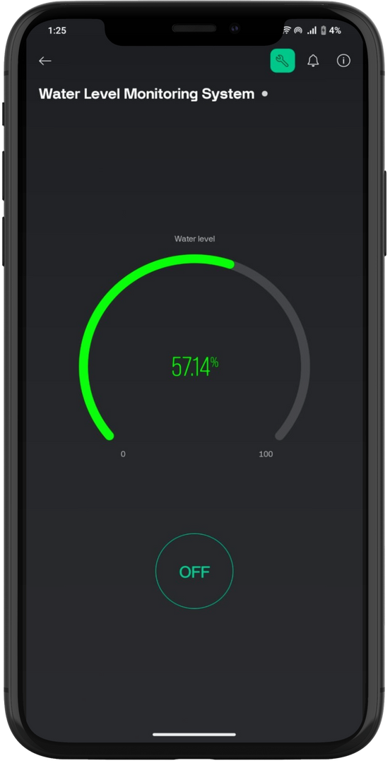
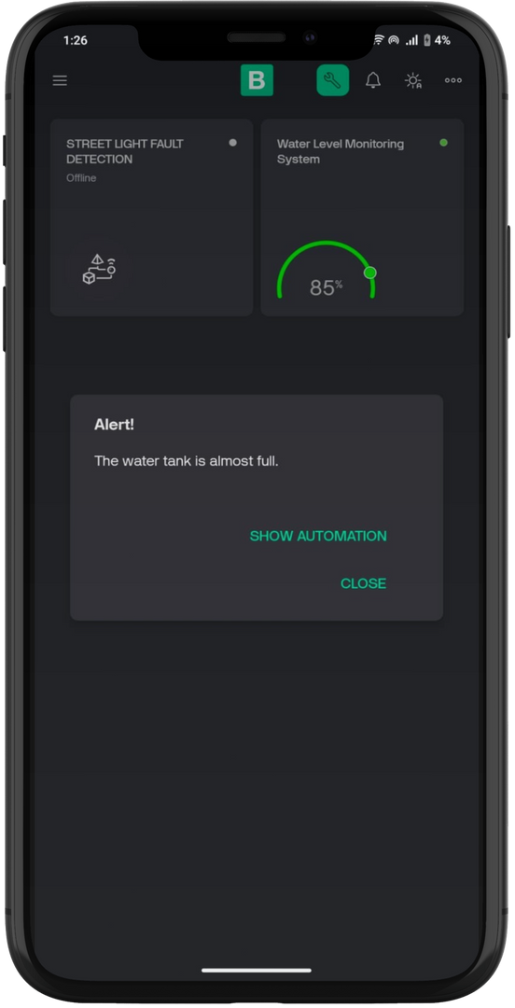

Slide 9
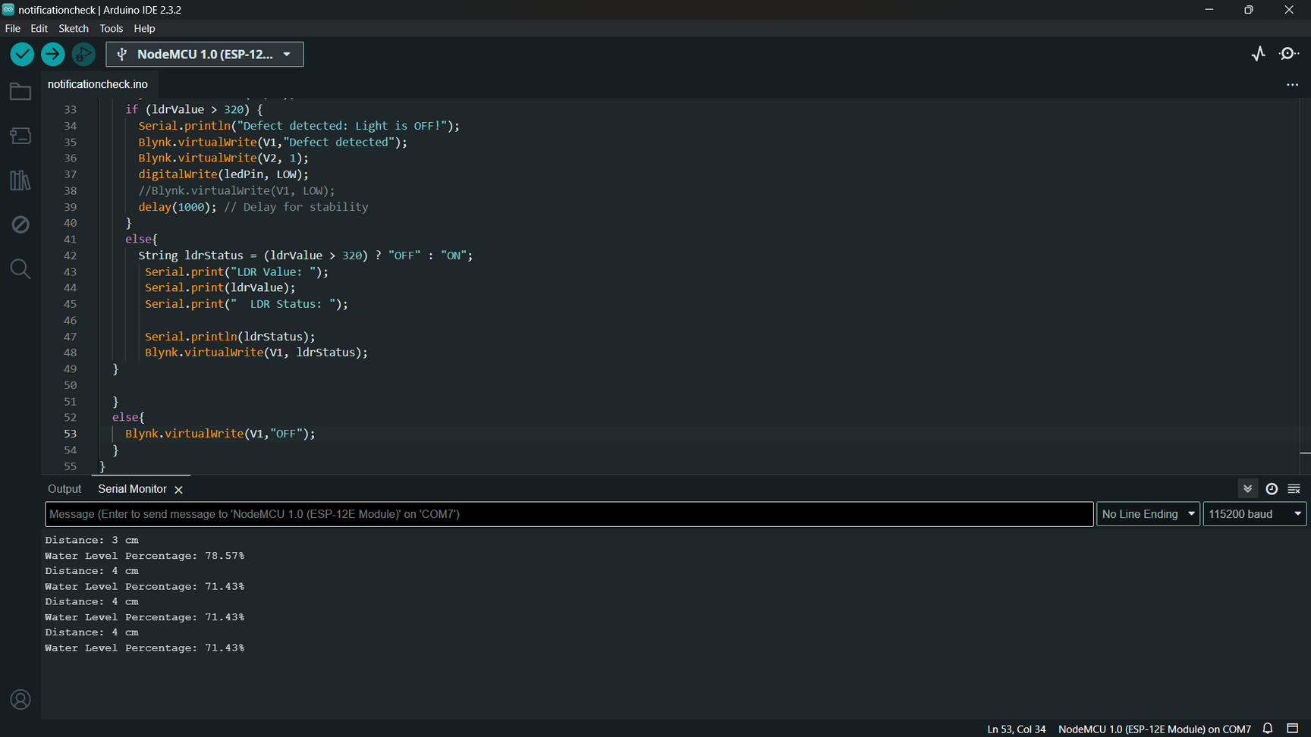

Slide 10
CONCLUSION AND FUTURE ENHANCEMENT
The smart water level monitoring and control system using the ESP8266 microcontroller and Blynk platform effectively addresses the shortcomings of traditional methods by providing accurate, real-time measurements and remote monitoring capabilities, thus enhancing water management efficiency and sustainability. Future enhancements could include integration with smart home systems for voice control, predictive analytics for optimized water usage, support for multi-tank monitoring, solar power integration for remote locations, advanced notifications for maintenance and leak detection, water quality monitoring, automatic pump control based on water levels, and improved user interface for detailed analytics and customizable alerts. These advancements will further enhance the system's robustness, versatility, and utility in various water management applications.

Slide 11
Thank you
for listening!

